Slide 1

Strengthening Family and Fellowship
Careful Steps to Our Ultimate Objective - 10:1-33
Week 64
20 September 2023

Slide 2

1 Corinthians Introduction
As we continue our study in First Corinthians, we are reminded that the theme of this letter revolves around Christian Conduct in the local church and how it influences unity, discipline, and spiritual growth …
Remember, the overarching issue in the church at Corinth is “Progressive Sanctification” – the development of Holy character and the application of Christian principles and discipline on an individual and corporate level. So the corrective in this letter is behavior rather than doctrine.
In our final lesson on “Strengthening Family and Fellowship” Paul addresses the importance of learning from Israel's history, avoiding idolatry, understanding the significance of the Lord's Supper, practicing selflessness, and staying vigilant against compromising situations.

Slide 3
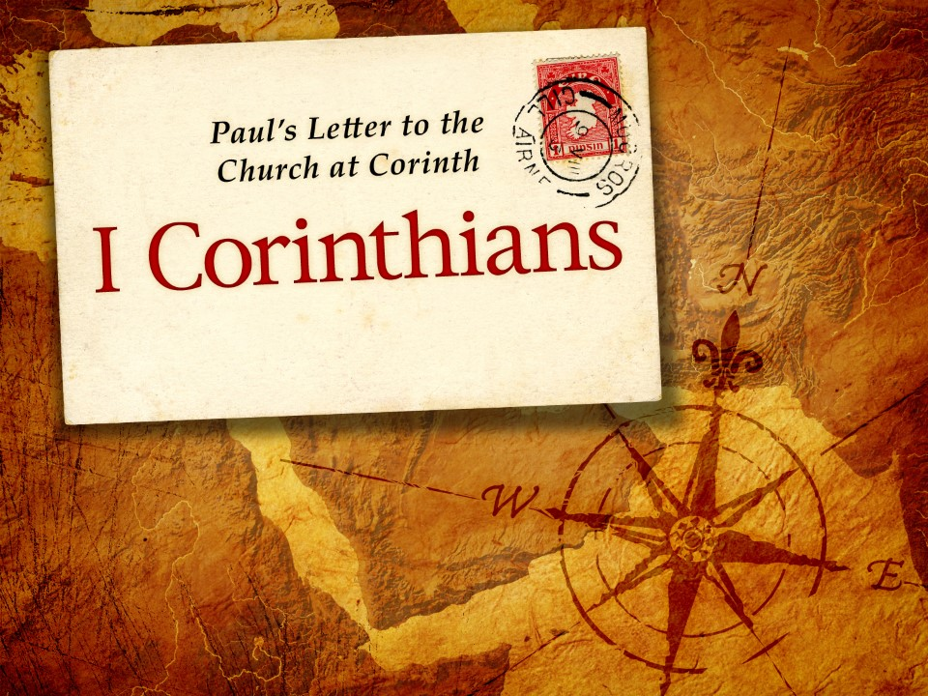
Careful Steps to Our Ultimate Objective
10:1-33

Slide 4
1 Corinthians - Lesson Overview
Swindoll … opens our lesson with a story from Russian novelist Alexander Solzhenitsyn classic novel “One Day in the Life of Ivan Denisovich,” a prisoner in a Siberian labor camp.
While our context and that of Ivan Denisovich are worlds apart, many of the arguments made, in the novel, resonates with our own society.
Issues of personal loyalty, human dignity, and faith. Yet amid all these themes of human existence, one theme that shouldn’t be missed, is that of the “purpose” our lives can have when we live with a clear ultimate objective set before us.
Persistently hungry, chilled to the core, and cursed with every reason to give in to despair, Ivan Denisovich had a job to do, a reason to face each morning.

Slide 5
1 Corinthians - Lesson Overview
His task was to build a wall from brick and mortar. He took simple pride in just knowing he had made it through another day and was constructing a fine wall.
Rather than fumbling through his daily existence wondering when his pointless life would end in Siberia’s gray, subzero winter, Ivan approached each day with renewed resolve, determination and “purpose.”
Just as Ivan Denisovich built his wall with barrows of brick and buckets of mortar, so Paul, “our wise master builder,” laid the foundation of the church in Corinth.
Then he charged the believers in Corinth with the daily task of building upon it – brick by brick, one carefully placed piece at a time.

Slide 6
1 Corinthians - Lesson Overview
Their job was simple: Build up the body of Christ.
With this goal clearly in mind, Paul also gives them detailed instructions for daily construction.
The problem was that the Corinthian believers had each been building their own little dwellings for themselves with no regard for the glorious temple they were supposed to be constructing together.
They had forsaken the authentic fellowship of the body for self-centered focuses that weaken and injure the body rather than heal and strengthen it.

Slide 7
1 Corinthians - Lesson Overview
So beginning with the example of the Hebrews in the wilderness, Paul urges the Corinthians to stick to the guidelines God had given them to live by (10:1-11).
Then he returns to the theme introduced in chapter eight, eating meat consecrated to the idolatrous worship of false gods, contrasting it with the proper worship and fellowship in the body of Christ (10:12-22).
Lastly, he leads the Corinthian believers to refocus their efforts on the ultimate purpose of life: The glory of God (10:23-31).

Slide 8
1 Corinthians 10:1-5
¹Moreover, brethren, I do not want you to be unaware that all our fathers were under the cloud, all passed through the sea, ²all were baptized into Moses in the cloud and in the sea, ³all ate the same spiritual food, ⁴and all drank the same spiritual drink. For they drank of that spiritual Rock that followed them, and that Rock was Christ. ⁵But with most of them God was not well pleased, for their bodies were scattered in the wilderness.

Slide 9
1 Corinthians 10:1-5
Paul stresses that the way forward for the Corinthians begins by looking to the past. He points specifically to the Jewish exodus from Egypt and their experience as the people of God in the wilderness wanderings.
He appealed to their history as an illustration because the believers in Corinth needed to learn the same lesson as the children of Israel.
Neither the Israelites of old nor the Corinthians in Paul’s day could blame their failure to follow God’s guidelines on receiving unclear instructions.
Both had been privileged to receive the latest and greatest revelations from God in their own days, revelations so astounding that they would become both the objects of unparalleled faith and of cynical disbelief for millennia.

Slide 10
1 Corinthians 10:1-5
Paul draws analogies between the Hebrews’ exodus from slavery in Egypt and the Corinthians from a life of slavery to sin (10:1-4).
Paul employs a common first-century Jewish rhetorical device called a “typology” derived from the Greek word “typos” used for the word “example” “Now these things became our examples” ( 11:6), and “Now all these things happened to them as examples and they were written for our instruction, upon whom the ends of the ages have come” (11:11).
Swindoll quoting Grant Osborne offers this distinction between typology (týpos) and prophecy and its use in the New Testament.

Slide 11
1 Corinthians 10:1-5
Saying … “Typology” differs from direct prophecy, in that the latter texts [prophecies] are forward looking and directly predict the New Testament event.
While typology is indirect and analogously relates the Old Testament event to the New Testament event. The early Christians, like the Jews, saw all of salvation history . . . as a single continuous event.
Therefore events in the past are linked to those in the present, so that God’s mighty deeds like the exodus or the return from exile foreshadow the experiences of God’s present community, the Church.

Slide 12
1 Corinthians 10:1-5
By correlating New Testament truths with Old Testament events, Paul reminds the Corinthians of their miraculous deliverance from slavery to sin and their present life of deliverance.
They understood how these events foreshadowed their initiation into faith, including baptism and the Lord’s Supper.
The idea of being “baptized into Moses” (10:2) appears confusing, until we understand that Paul’s analogy pulls together three distinct but inseparable ideas concerning baptism in the New Testament:
Baptism in water as an outward symbol of faith, baptism by the Holy Spirit as a spiritual reality and that both spiritual and physical baptisms are literally immersions “into Christ Jesus” (Rom. 6:3).

Slide 13
1 Corinthians 10:1-5
That is, just as a garment immersed in dye emerges a different color, so also a person baptized into a particular teacher’s worldview emerges a devoted convert to that new teaching and new way of life.
Moses did not perform any baptism ceremonies, but the circumstances of the Exodus were a picture of spiritual and physical baptism, as people trusted Moses’ God-given words and were delivered.
With this reference to this Old Testament baptism “into Moses” (10:2), “simply means they were initiated and inaugurated under God into union with God and with Moses and his leadership.”

Slide 14
1 Corinthians 10:1-5
God’s presence among the people in the cloud, the deliverance via the Red Sea, the prophetic leadership of Moses, and heavenly food and drink.
Every one of these privileges was much more than the provision of a physical need for the ancient Israelites. Each of them was also an act of divine grace.
In our lives, too, there is no gift, blessing, or privilege we enjoy that meets only a physical need. With each kindness shown to us, even the seemingly small acts of provision – God shines forth His grace and mercy toward us.
What was true of the Hebrews in the Old Testament is true of Christians in the New Testament.

Slide 15
1 Corinthians 10:1-5
You would think that a people as blessed as the Hebrews would have instantly and unquestioningly responded to God with thankfulness and obedience.
But it didn’t unfold that way in the wilderness of Sinai. After listing their may blessings, Paul explains that God was “not well pleased” with most of them (10:5).
Out of hundreds of thousands of Israelites in that first generation that escaped Egypt, only Joshua and Caleb pleased God.
The rest of the rebellious Israelites – bestowed with indescribable physical and spiritual blessings – were strewn across the wilderness over the next forty years.

Slide 16
1 Corinthians 10:6-11
⁶Now these things became our examples, to the intent that we should not lust after evil things as they also lusted. ⁷And do not become idolaters as were some of them. As it is written, “The people sat down to eat and drink, and rose up to play.” ⁸Nor let us commit sexual immorality, as some of them did, and in one day twenty-three thousand fell; ⁹nor let us tempt Christ, as some of them also tempted, and were destroyed by serpents; ¹⁰nor complain, as some of them also complained, and were destroyed by the destroyer. ¹¹Now all these things happened to them as examples, and they were written for our admonition, upon whom the ends of the ages have come.

Slide 17
1 Corinthians 10:6-11
Swindoll says … “What a spectacle is that which is called up by the apostle before the eyes of the self-satisfied Corinthians: all those bodies sated with miraculous food and drink, littering the soil of the desert!”
Paul, now uses the Hebrews disobedience and judgment as a warning to the believers in Corinth. Noting how they fail to please God who had delivered them, he points out the vices that the Hebrews and the Corinthians had in common.
They craved evil things (10:6)
They engaged in idolatry (10:7)
They became immoral (10:8)
They tested the Lord’s faithfulness (10:9)
They grumbled against God’s leaders (10:10)

Slide 18
1 Corinthians 10:6-11
They craved evil things (10:6). Paul starts this list by identifying a deep-seated attitude of the heart – lusting after evil. Dissatisfied and ungrateful for their blessings, the Hebrews kept longing to go back to Egypt (Num. 11:4-6).
The Corinthians, like many believers today, struggled against their former lifestyles, tempted to “go back” to the evil of their past (6:9-11).
They engaged in idolatry (10:7). After being delivered by the great “I AM,” the Hebrews fashioned a golden calf idol and declared it to be their god. An idol is anything that take God’s rightful place on the throne of our lives.
The Corinthians, like many today, placed other people and other things above the appropriate and solitary lordship of Christ (3:3-4).

Slide 19
1 Corinthians 10:6-11
They became immoral (10:8). The Israelites turned their idolatry that began with an evil attitude and continued with a substitution of other things for God, into a drunken orgy resulting in immoral corruption of character and action (Ex. 32:6-7).
The Corinthians, too, had their share of impurity in attitude and practice (5:1-2).
They tested the Lord’s faithfulness (10:9). Doubting God’s faithfulness to provide for them, they asked Moses “Why have you brought us up out of Egypt to die in the wilderness?” God responded with judgment (Num. 21:5-6). Daring God to come through on His promises showed a lack of faith.
Like the Hebrews, some in Corinth, failed to fully believe even the basic tenets of Christian doctrine (15:12).

Slide 20
1 Corinthians 10:6-11
They grumbled against God’s leaders (10:10). When the Hebrews didn’t get what they wanted, they complained bitterly and relentlessly against God’s ordained leadership (Num. 16:41; 17:5, 10).
The Corinthians Christian, too, in a context of self-seeking, schism, were inclined to complain, grumble, and rebel against those who had been placed in authority over them.

Slide 21
1 Corinthians 10:12-15
¹²Therefore let him who thinks he stands take heed lest he fall. ¹³No temptation has overtaken you except such as is common to man; but God is faithful, who will not allow you to be tempted beyond what you are able, but with the temptation will also make the way of escape, that you may be able to bear it. ¹⁴Therefore, my beloved, flee from idolatry. ¹⁵I speak as to wise men; judge for yourselves what I say.

Slide 22
1 Corinthians 10:12-15
The point of Paul’s typological application of the tragic events following the Hebrews exodus rang loud and clear.
The Corinthians were headed for a similar kind of judgment by the hand of God if they didn’t repent of their own lust, idolatry, immorality, unfaithfulness and grumbling.
In the name of celebrating their liberty from the Law, forgiveness from past, present, and future sins, and freedom of conscience in Christ, the Corinthians participated in idolatrous practices at the local temples. Paul explains, this is just one curve on the downward spiral into demon worship.
They believed that their baptism in the Holy Spirit, seal of water baptism, and participation in the grace-giving life of the church provided them an infinite expense account to spend on sin.

Slide 23
1 Corinthians 10:12-15
To shock the Corinthians out of this twisted theology they received a sobering warning from Paul “Therefore let him who thinks he stands take heed that he does not fall” (10:12).
In essence, Paul is saying look at this again … “If you think that you will avoid the disciplining hand of God’s judgment because you are a Christian, take a closer look: Realize that you – yes, even you are liable to the discipline of a Holy God.”
Even with Paul’s stern warning comes positive encouragement.
Though the Corinthians faced all kinds of trials and temptations, God promises that He will faithfully “provide the way of escape” from these temptations and tests of faith.

Slide 24
1 Corinthians 10:12-15
The Greek translation of this word “temptation” refers to the test that challenges the integrity of our faith (1Pet. 1:6); and to the things that appeal to our sinful tendencies and challenge our moral integrity (Luke 4:13).
While 10:13, seems to be speaking of the everyday snares of sin, it can also be speaking of the trials of faith that come with everyday living. In either case, Paul says that up to this point they only had to deal with the temptations “common to man.”
But now, because Paul is about to discuss the spiritual, demonic dimension of idolatry, he may be suggesting this as their opportunity to turn away from their current, course of spiritual decline before they find themselves in a situation that would be harder to escape, but not impossible (10:13).

Slide 25
1 Corinthians 10:12-15
The Corinthians desperately need this encouragement, they had chosen to live on the unraveling fringe of the Christian experience. Living dangerously close to the pagan world, surrounded with all of its temptations.
Paul’s exhortation to “Flee from idolatry” (10:14), was his warning that if they kept going in the same direction, what begun as a celebration of liberty would end as a cry of bondage to sin, complete with demonic oppression.
Because Paul understood the devastating implications of outright participation in idolatrous worship . . .
He places this warning like a flashing sign in front of the straying Corinthians urging them to put the brakes on their drifting and leave the idolatrous practices behind (10:15).

Slide 26
1 Corinthians 10:16-22
¹⁶The cup of blessing which we bless, is it not the communion of the blood of Christ? The bread which we break, is it not the communion of the body of Christ? ¹⁷For we, though many, are one bread and one body; for we all partake of that one bread. ¹⁸Observe Israel after the flesh: Are not those who eat of the sacrifices partakers of the altar? ¹⁹What am I saying then? That an idol is anything, or what is offered to idols is anything? ²⁰Rather, that the things which the Gentiles sacrifice they sacrifice to demons and not to God, and I do not want you to have fellowship with demons. ²¹You cannot drink the cup of the Lord and the cup of demons; you cannot partake of the Lord’s table and of the table of demons. ²²Or do we provoke the Lord to jealousy? Are we stronger than He?

Slide 27
1 Corinthians 10:16-22
After his initial warning, Paul asserts that … association with idolatry leads to participation in false religion.
Using two examples the “Lord’s Table” and the “Nation of Israel” Paul shows the Corinthians how the first step toward spiritual disaster occurs (10:16-18).
Noting that sharing or “koinonia” the Greek word used for “intimate fellowship with one another” is used three time in this passage. When believers properly partake of the bread and wine of communion, they participate in a confession of faith that they can see, taste, smell, touch, and hear.
In the fullest physical sense, believers confess the incarnation of the God-man, who took on real flesh and blood, died for our sins, and rose from the dead to give us new life.

Slide 28
1 Corinthians 10:16-22
Now, with Christ presiding at the table as the host of His supper and by participating in the “cup of blessing” and the “one bread,” believers are fellowshipping with Jesus through the Holy Spirit (John 14:16-17).
They are also fellowshipping with one another as “one body,” united in this solemn observance (10:17).
Just as the Israelites had also participated with God in fellowship and worship through the sacrifices of the Old Testament Law (Deut. 12:18).
It was Jesus, the unseen host of the Lord’s Supper, and God the Father, the unseen reason behind the sacrifices of Israel, who made these things meaningful and powerful.

Slide 29
1 Corinthians 10:16-22
Having taken his readers back to the issue he first introduced in chapter eight, Paul clarifies his warning about the spiritual dangers of idolatry (10:19-20).
He reaffirms that there is nothing inherently good or bad with the actual meat sacrificed to an idol (8:8), since idols are merely physical objects that have no power in and of themselves.
But he clarifies that there is real danger in the demonic spirits that people have spiritual fellowship with when they engage in the idolatrous sacrificial worship in the pagan temples.

Slide 30
1 Corinthians 10:16-22
Swindoll quoting R. C. H. Lenski says … “It is a great mistake to imagine that back of their idolatry and their idol sacrifices there is nothing but an empty vacuity.
True enough, as 8:4 make plain, the gods of the idols have not existence whatever: No being by the name of Jupiter exists, and this is true with respect to the other gods.
But something does exist, something that is far more terrible than these pseudo-gods, namely an entire kingdom of darkness which is hostile to God, a host of demons or fallen angles who are ruled by the greatest of their number, namely Satan.”

Slide 31
1 Corinthians 10:16-22
The heart of the problem with Corinthians Christians showing up at the pagan temples to partake of the best charbroiled steaks in town, hot off the grill, was that their presence and their actions were precisely the same as those engaged in the worship of demons.
Like fire and water, Satan and Christ don’t mix (10:21). God won’t tolerate split loyalties. He never did in Israel’s day (Deut. 32:21-25), and He didn’t in the Corinthians day and He doesn’t in our day.
When it comes to us splitting our loyalties between the one true God and demonic idols, our God is rightly a jealous God (10:22). A fact we must never forget!

Slide 32
1 Corinthians 10:23-33
²³All things are lawful for me, but not all things are helpful; all things are lawful for me, but not all things edify. ²⁴Let no one seek his own, but each one the other’s well-being. ²⁵Eat whatever is sold in the meat market, asking no questions for conscience’ sake; ²⁶for “the earth is the Lord’s, and all its fullness.” ²⁷If any of those who do not believe invites you to dinner, and you desire to go, eat whatever is set before you, asking no question for conscience’ sake. ²⁸But if anyone says to you, “This was offered to idols,” do not eat it for the sake of the one who told you, and for conscience’ sake; for “the earth is the Lord’s, and all its fullness.” ²⁹“Conscience,” I say, not your own, but that of the other. For why is my liberty judged by another man’s conscience? ³⁰But if I partake with thanks, why am I evil spoken of for the food over which I give thanks? ³¹Therefore, whether you eat or drink, or whatever you do, do all to the glory of God. ³²Give no offense, either to the Jews or to the Greeks or to the church of God, ³³just as I also please all men in all things, not seeking my own profit, but the profit of many, that they may be saved.

Slide 33
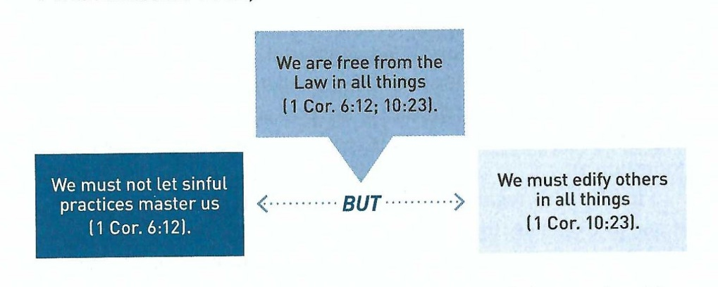
1 Corinthians 10:23-33
Paul concludes this section regarding strengthening authentic fellowship in the body of Christ by reiterating the theme first introduced in chapter six: “All things are lawful, but not all things are profitable” (6:12, 10:23).
Putting these principles together we get both the positive and negative boundaries for exercising our Christian liberty.

Slide 34
1 Corinthians 10:23-33
Swindoll says … “The guidelines for wisely determining whether we should or should not engage it what otherwise would be neutral practices we should ask ourselves these three questions.”
Does the practice avoid a wicked, immoral lifestyle (6:12-20)?
Does the practice seek the good of our brothers and sisters in Christ (10:23)?
Does the practice ultimately bring glory to God (6:20; 10:31)?
So, to sum up Paul’s argument about meat sacrificed to idols let’s use the “Temple Sacrificed Meat” diagram and again ask these three questions.

Slide 35
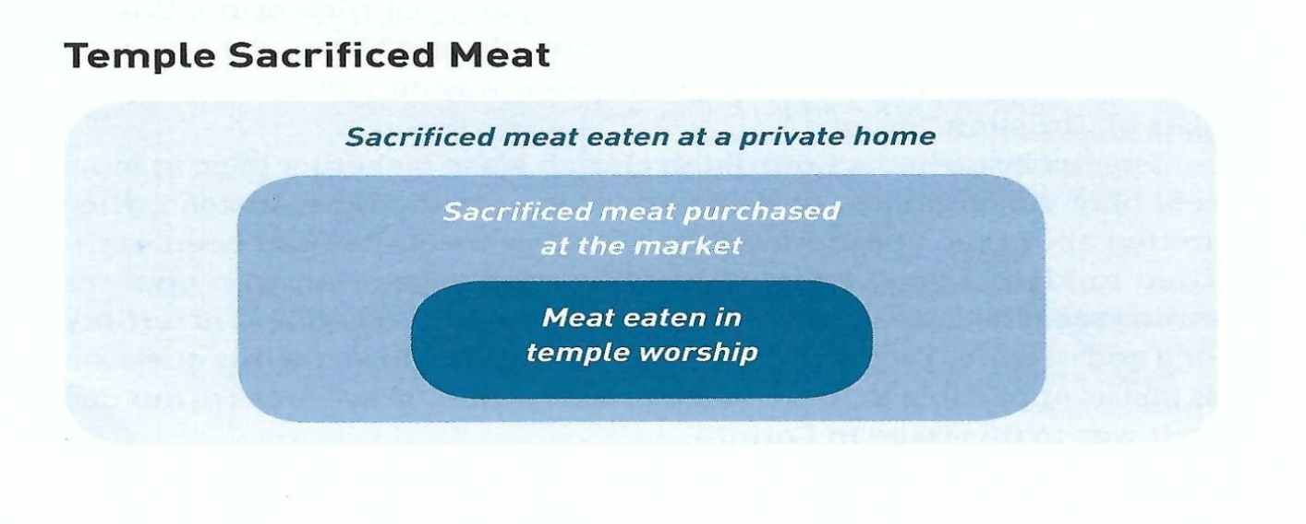
1 Corinthians 10:23-33
With regard to eating meat while involved in temple worship, to Paul this was a no-brainer.
  This practice engages in idolatry and spiritual immorality (1), it causes other brothers and sisters in Christ to follow into sin (2), and it dishonors God by worshiping demons (3).

Slide 36
1 Corinthians 10:23-33
Concerning sacrificed meat purchased at the meat market. Paul says …“Eat anything sold in the market without asking questions for conscience’ sake” (10:25).
  If we treat the meat as a harmless creation of God purchased in a neutral environment (10:26), then it does not involve idolatry and immorality (1), it does not cause a weaker brother or sister to stumble (2), and it glorifies God when the food is received with thanksgiving (10:30), (3).

Slide 37
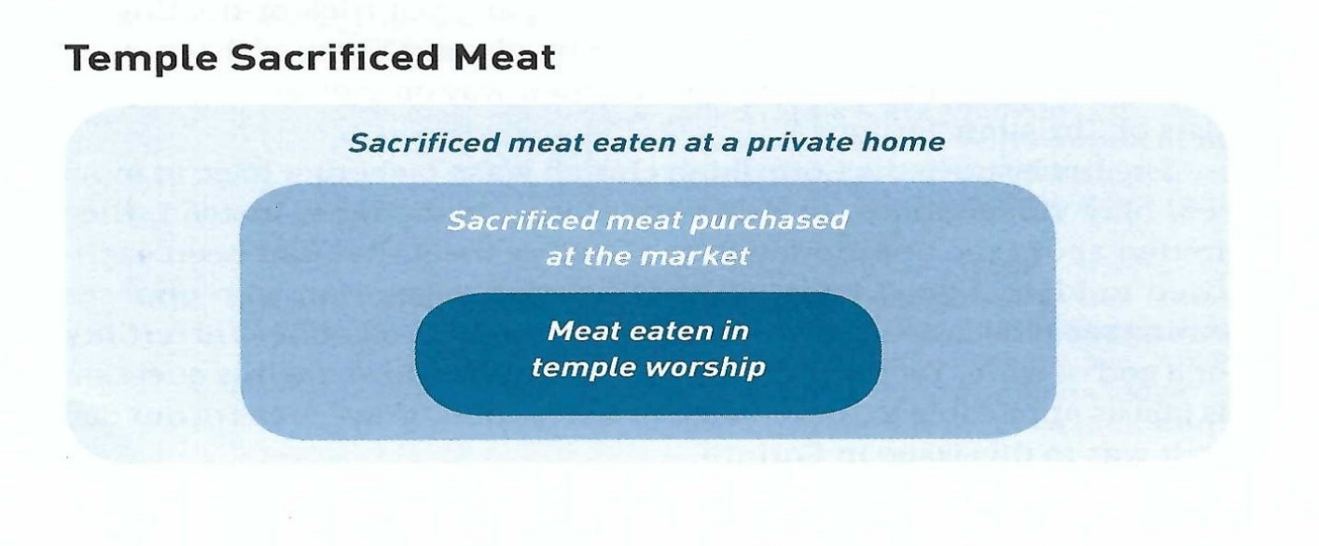
1 Corinthians 10:23-33
Finally, for sacrificed meat eaten at an unbelievers home, if where it came from is not mentioned, eat freely (10:25).
  If the one serving the guests makes a point that the meat was sacrificed to idols, then he’s likely viewing the meal as an extension of his devotion to the pagan god. In that case, for the sake of our Christian testimony and the conscience of weaker believers, we should not eat the food (10:27-29).

Slide 38
1 Corinthians 10:23-33
Ultimately, Christians should be willing to set aside their right to exercise Christian freedom for the sake of fellowship with God and with one another.
  While we must never surrender our stand on the non-negotiable truths of the person and work of Jesus Christ – even if it seems like foolishness to the world (1:17-18).
  When it comes to questionable, optional, or “gray” areas of our practice, we should eagerly heed Paul’s command: “Give no offense, either to the Jews or to the Greeks or to the church of God; just as I also please all men in all things, not seeking my own profit, but the profit of many, that they may be saved” (10:32-33).

Slide 39
Applications
Of the
lesson
Keeping the “Ps”

Slide 40
Application – Keeping the “ps”
Every day Christians are faced with decisions – not simply between right and wrong, but between good, better and best.
God has given us a world filled with beauty for us to enjoy, but how do we determine where to draw the line between delighting in His gracious provision and overindulging in sinful desires?
As we seek to put into practice the teachings here let’s consider these three basic principles that will equip us to make wise, healthy decisions and set us on a course for a God-honoring life:
The Profit Principle (10:23).
The People Principle (10:24, 33).
The Purpose Principle (10:31).

Slide 41
Application – Keeping the “ps”
The Profit Principle (10:23).
The profit principle reminds us that our freedom in otherwise neutral matters is not to be exercised at another’s expense, but for another’s profit.
As we consider everything from how we spend our time to how we spend our money, we should constantly ask ourselves some probing questions.
Who will benefit from this? How will they benefit? Would other actions be more profitable? This kind of thinking will work against our natural tendency toward self-centeredness.
In theory, Christians are free to participate in any activity not immoral in themselves, we are also called to focus on those things that will benefit others (Rom. 14:19-20).

Slide 42
Application – Keeping the “ps”
The People Principle (10:24, 33).
Closely tied to the profit principle is the people principle. As we seek to engage in activities and make decisions that are more profitable for others, we need to be careful that we truly have the good of others in mind.
This means getting to know people. Not just their names. Not just their resumes. It means getting to know their needs, their hurts, their strengths and weaknesses. Only then can we actually answer the question, “Is this in their best interests?”
Giving people what they want or fulfilling their immediate desires isn’t always what will benefit them most. As in parenting, sometimes the greatest profit for a child comes from withholding what the child desires. Sometimes it means giving the child what they don’t want (Phil 2:3-4).

Slide 43
Application – Keeping the “ps”
The Purpose Principle (10:31).
The purpose principle is our reminder to be intentional. Do you eat or drink? Do it to the glory of God. Do you preach or teach? Do it to the glory of God. Whether you clean houses, raise children or run for president – all of these things should be done with one purpose: God’s glory!
We shouldn’t just think of the big career choices. Even the “little things” in life that tend to be done reluctantly behind the scenes, should be done with God’s glory as our focus, pleasing Him, as if in His service.
Things like cleaning house, washing dishes, caring for the sick, even moving chairs at church. Whatever you do, consider it a service to your God. He owns it all anyway: your life, your time, your energy. It’s all on loan from Him (10:31).

Slide 44


Careful Steps to Our Ultimate Objective

Slide 45
NEXT CLASS – 27 September 2023
Book of First Corinthians
Before next class, read the below chapters in the NKJV and in one other versions of the Bible, i.e., KJV, NRSV, NIV, CEV, etc …
Chapter 11:1 – 16
“Of Hair and Hats”

